Slide 1
2019 MVL Lab Training Course
Computer Vision & Deep Learning - 1
Presenter: Hao-Ting Li (李皓庭)

Slide 2
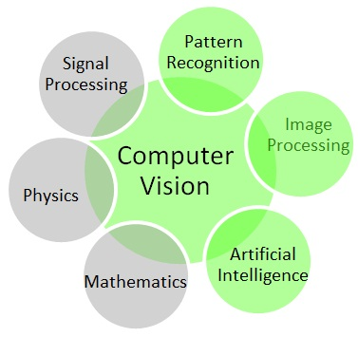
To Accomplish Computer Vision...

Slide 3
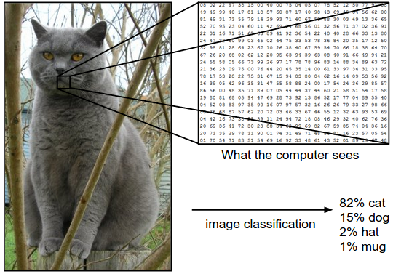
Image Classification
The task in Image Classification is to predict a single label (or a distribution over labels as shown here to indicate our confidence) for a given image. Images are 3-dimensional arrays of integers from 0 to 255, of size Width x Height x 3. The 3 represents the three color channels Red, Green, Blue.

Slide 4
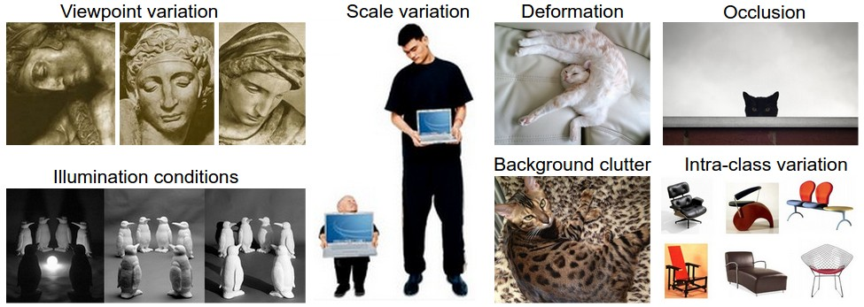
Challenges

Slide 5
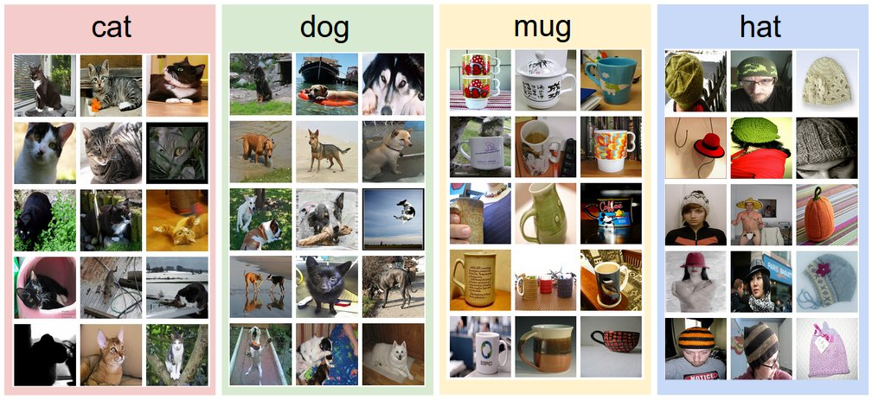
Data-driven Approach

Slide 6
The Image Classification Pipeline
Input
Our input consists of a set of N images, each labeled with one of K different classes. We refer to this data as the training set.
Learning
Our task is to use the training set to learn what every one of the classes looks like. We refer to this step as training a classifier, or learning a model.
Evaluation
In the end, we evaluate the quality of the classifier by asking it to predict labels for a new set of images that it has never seen before. We will then compare the true labels of these images to the ones predicted by the classifier. Intuitively, we’re hoping that a lot of the predictions match up with the true answers (which we call the ground truth).

Slide 7
Example Image Classification Dataset: CIFAR-10
60,000 tiny images that are 32 pixels high and wide
a training set of 50,000 images
a test set of 10,000 images
Each image is labeled with one of 10 classes (for example “airplane, automobile, bird, etc”)

Slide 8
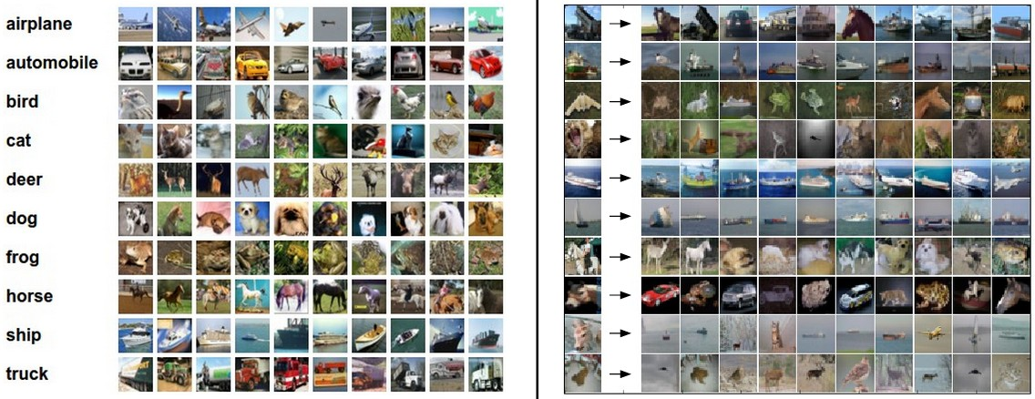
Example Image Classification Dataset: CIFAR-10

Slide 9
Nearest Neighbor Classifier
Take a test image
Compare it to every single one of the training images
Predict the label of the closest training image.

Slide 10

The Choice of Distance
L1 Distance
$$d_{1}\left(I_{1},I_{2}\right)=\sum_{p}{\left|I_{1}^{p}−I_{2}^{p}\right|}$$
L2 Distance
$$d_{2}\left(I_{1},I_{2}\right)=\sqrt{\sum_{p}{{\left(I_{1}^{p}−I_{2}^{p}\right)}^{2}}}$$

Slide 11
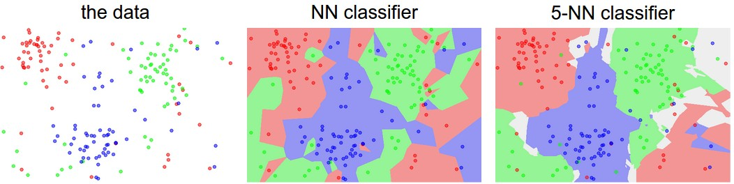
k - Nearest Neighbor Classifier
Instead of finding the single closest image in the training set, we will find the top k closest images, and have them vote on the label of the test image.
The colored regions show the decision boundaries induced by the classifier with an L2 distance. The white regions show points that are ambiguously classified (i.e. class votes are tied for at least two classes)

Slide 12
Validation Sets for Hyperparameter Tuning
Hyperparameter
k-NN, k=?
L1 norm or L2 norm?
We cannot use the test set for the purpose of tweaking hyperparameters
overfit to the test set
Solution:
Split our training set in two
a slightly smaller training set
validation set
e.g. CIFAR-10 50000 training set -> 40000 training set and 10000 validation set

Slide 13
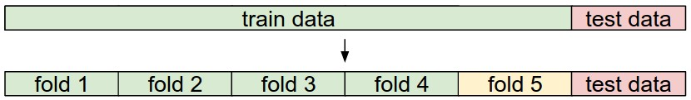
Cross-Validation
Example: 5-fold cross validation

Slide 14
Pros and Cons of Nearest Neighbor classifier.
Pros
simple to implement and understand
the classifier takes no time to train
Cons
pay that computational cost at test time
In practice, we often care about the test time efficiency much more than the efficiency at training time.

Slide 15
Summary
Image Classification
Nearest Neighbor classifier
Hyper-parameter
Validation set
Cross-Validation

Slide 16
Reference
CS231n: Convolutional Neural Networks for Visual Recognition
http://cs231n.github.io/classification/

